Slide 1
64-bit Adder using Ling equation

Slide 2
Critical Path
There are 8 stages to get the final sum
Stage 1: get carry generation signal(use domino AND) and carry propagation signal(use domino OR) for every bit position.
Stage 2 ~ 7: fuse carry generation signals and carry propagation signals in different bit positions. During the process of carry generation signals fusion, we use domino OR in stage 2 and domino AO in the other stages.
Stage 8: Use fused carry generation signals to select pre-compute sums.

Slide 3
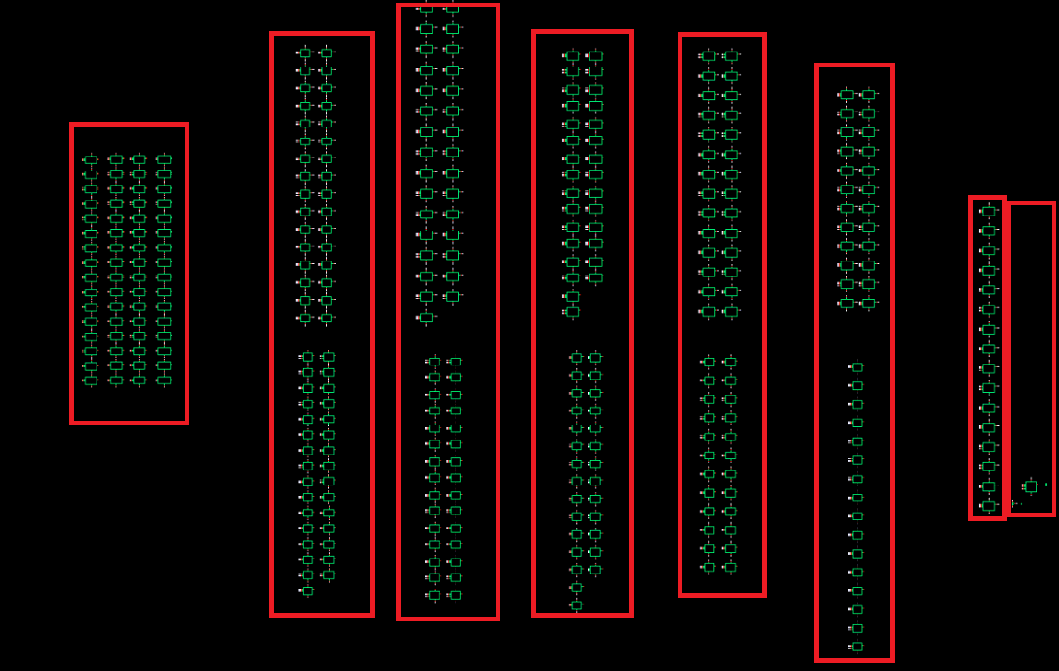
Critical Path
The total path is 1 domino and(domino or) + 1 domino or + 5 domino AO + 1 2:1 Mux

Slide 4
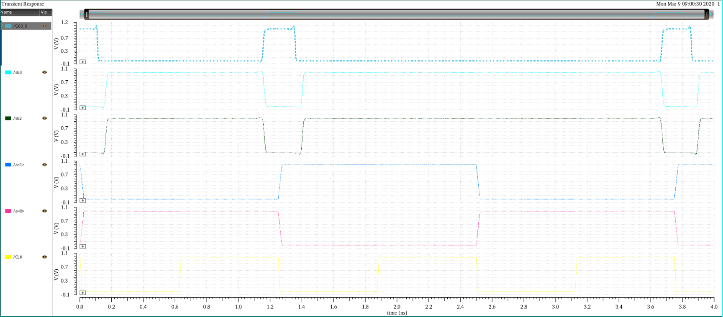
Simulation results
Clock period = 1.25ns(0000…0001 + 1111…1111)

Slide 5
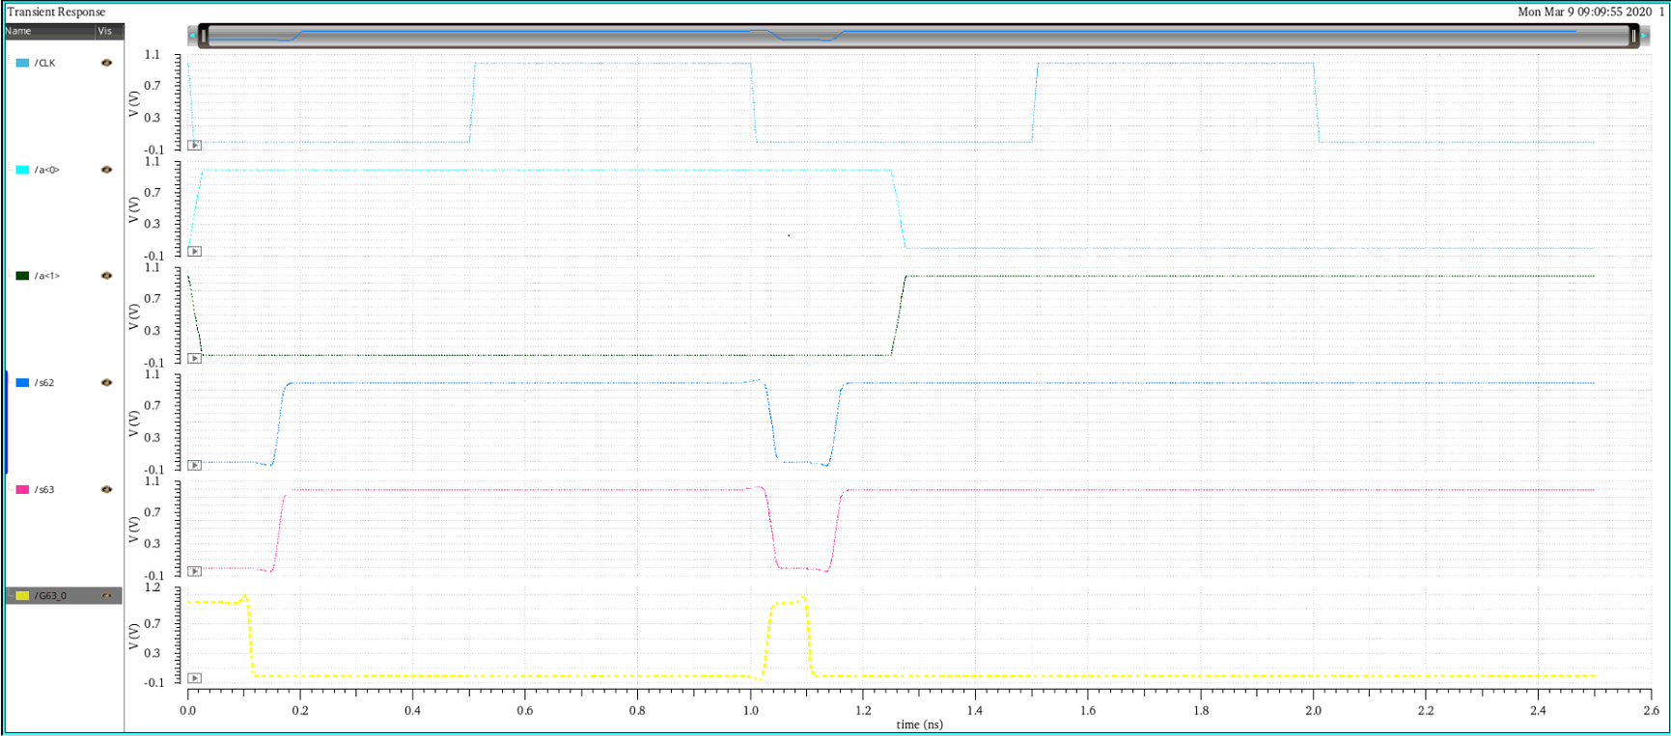
Simulation results
Clock period = 1ns(0000…0001 + 1111…1111)

